Slide 1
Campaign Optimization
Rashik Islam
13.07.2021

Slide 2
Outline
Problem Definition
Dataset Summary
Data Processing
Possible Baseline Models
Model Training
Result Comparison
Further Improvements

Slide 3
Problem Definition

Slide 4
Problem Definition
Future Performance: Prediction Horizon
Start of Advertisement History
24 hours; Point of prediction
t = n hours
Objective
Differentiate well performed advertisements
Increase purchase
Increase visibility (i.e. clicks)
Data collection

Slide 5
Dataset Summary

Slide 6
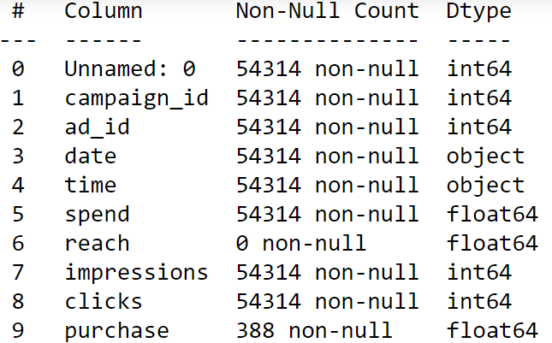
Dataset Summary
Unique campaigns found : 33
Unique advertisements found: 1061
Purchase column mostly contain None

Slide 7
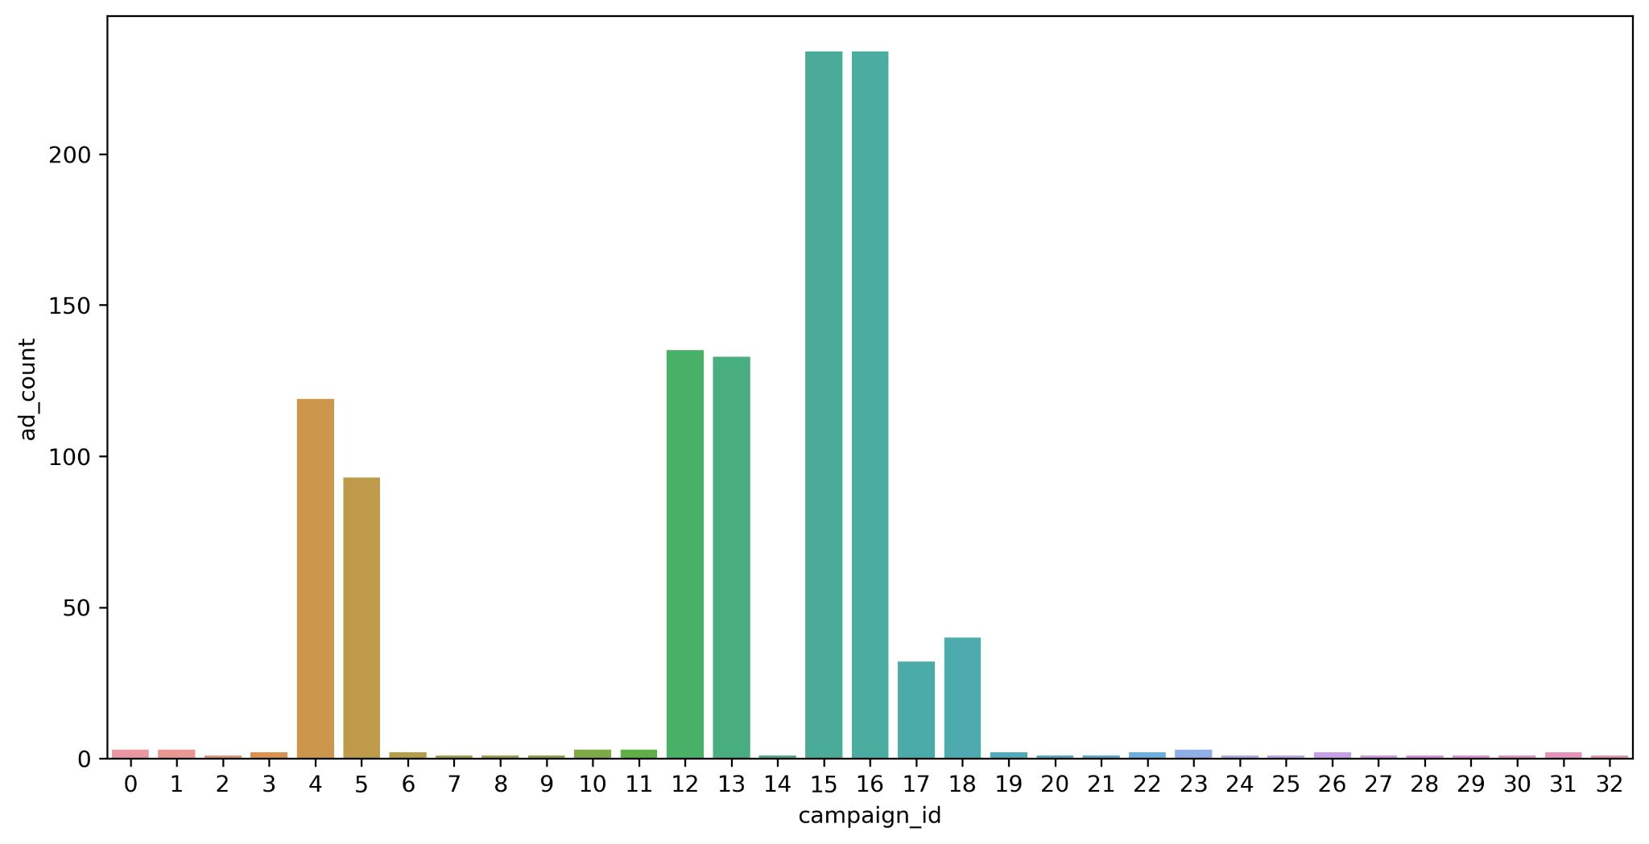
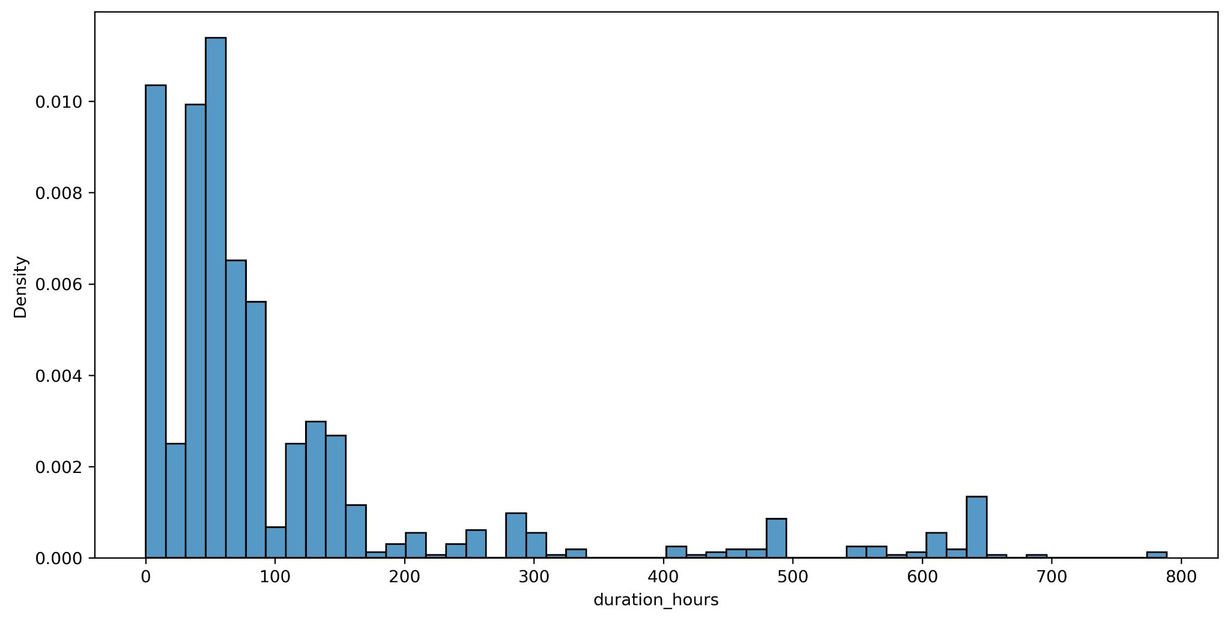
Dataset Summary: Preliminary EDA
Advertisements per campaign
Average: 32
Not evenly distributed
Density of advertisement lifetime
There are lot of ads not lasting 24 hours
Most found duration: 47 hours
Notes:
How ads are distributed amongst campaigns?

Slide 8
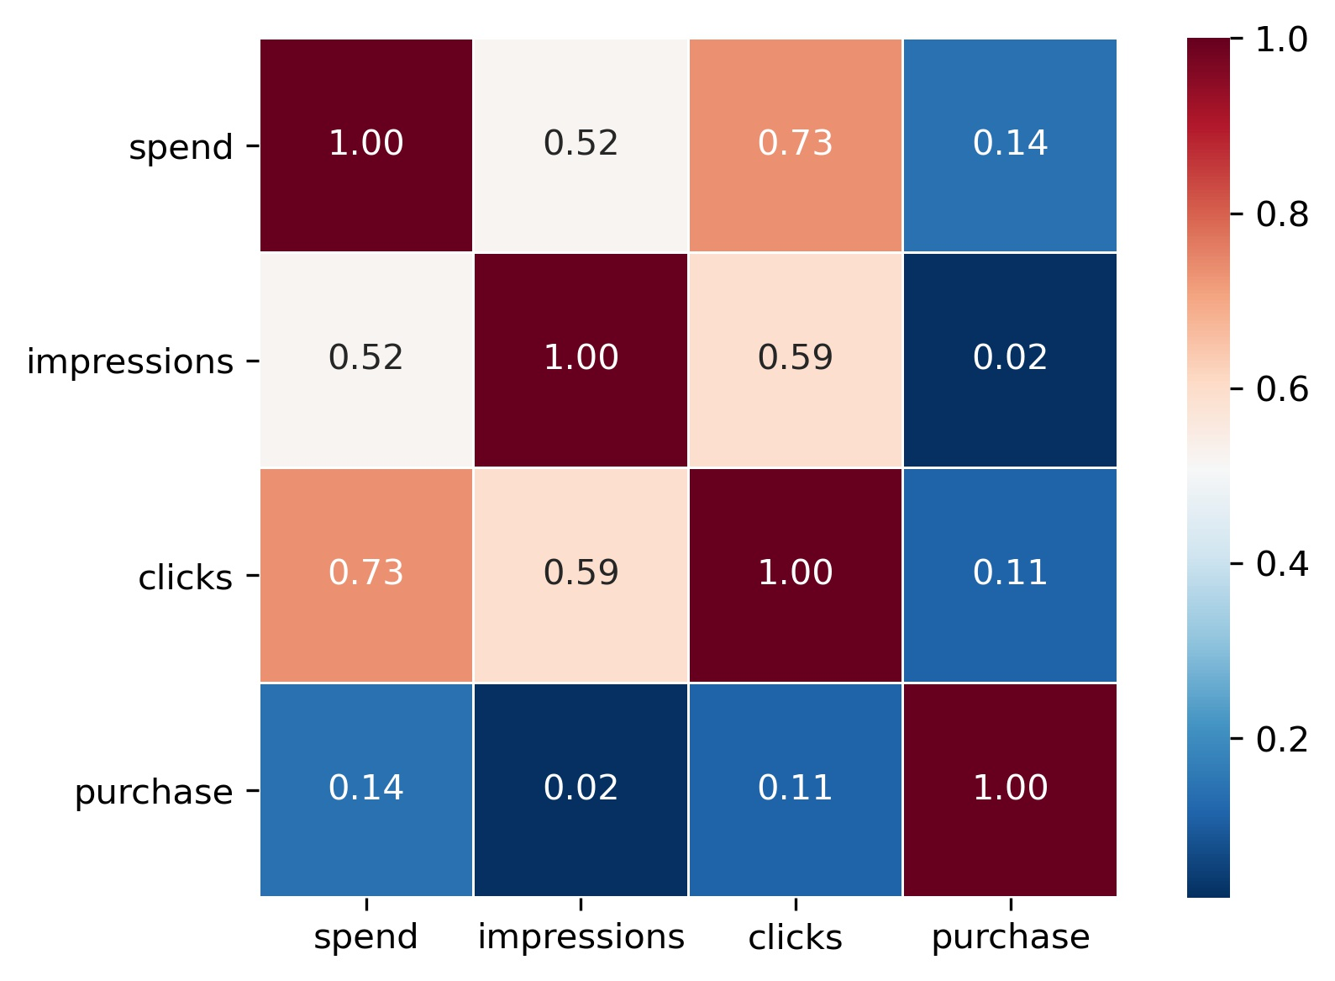
Dataset Summary: Preliminary EDA
Pairwise relationship: Nothing Unusual
Notes:
How ads are distributed amongst campaigns?

Slide 9
Data Processing

Slide 10
Data Preprocessing: Pipeline
Data
Get Valid Ads
Desired Test days per ad
Fill missing hours

Slide 11
Data Processing: Define, Calculate Target metric & Prediction horizon
Target metric consists of two KPIs
Click Through Rate: clicks/impressions
Conversion Rate: purchase/clicks
Target Metric: a custom weighted conversion rate:
(𝐶𝑇𝑅+ 𝑎𝑙𝑝ℎ𝑎∗𝐶𝑜𝑛𝑣𝑒𝑟𝑠𝑖𝑜𝑛𝑅𝑎𝑡𝑒)/𝑎𝑙𝑝ℎ𝑎+1
Prediction Horizon: Next Hour

Slide 12
Data Processing: Choose ML approach
Machine Learning approach
Regression
Classification

Slide 13
Data Processing: Choose ML approach
Machine Learning approach
Regression
Classification
Target Metric threshold:
Average CTR: 0.35%
Average Conversion rate: 2.35%
alpha = 2
(avg𝐶𝑇𝑅+ 2∗avg𝐶𝑜𝑛𝑣𝑒𝑟𝑠𝑖𝑜𝑛𝑅𝑎𝑡𝑒)/3 = 1.683

Slide 14
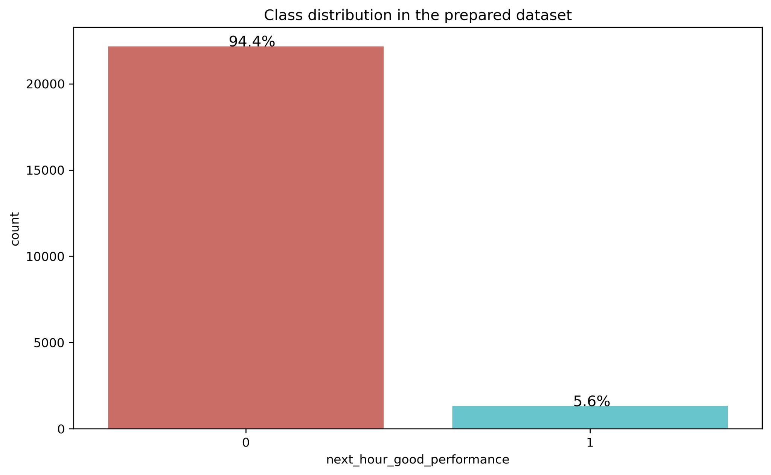
Data Processing: Class Distribution
Total sample: 23485
Campaigns: 32
Advertisements: 870
Training Sample: 20880 (89%)
Well performing ads : 5.6%
Test Sample: 2605(11%)
Well performing ads: 5.2%
Notes:
5 hourly info of ads missed in test set as they didn’t have data for next days.

Slide 15
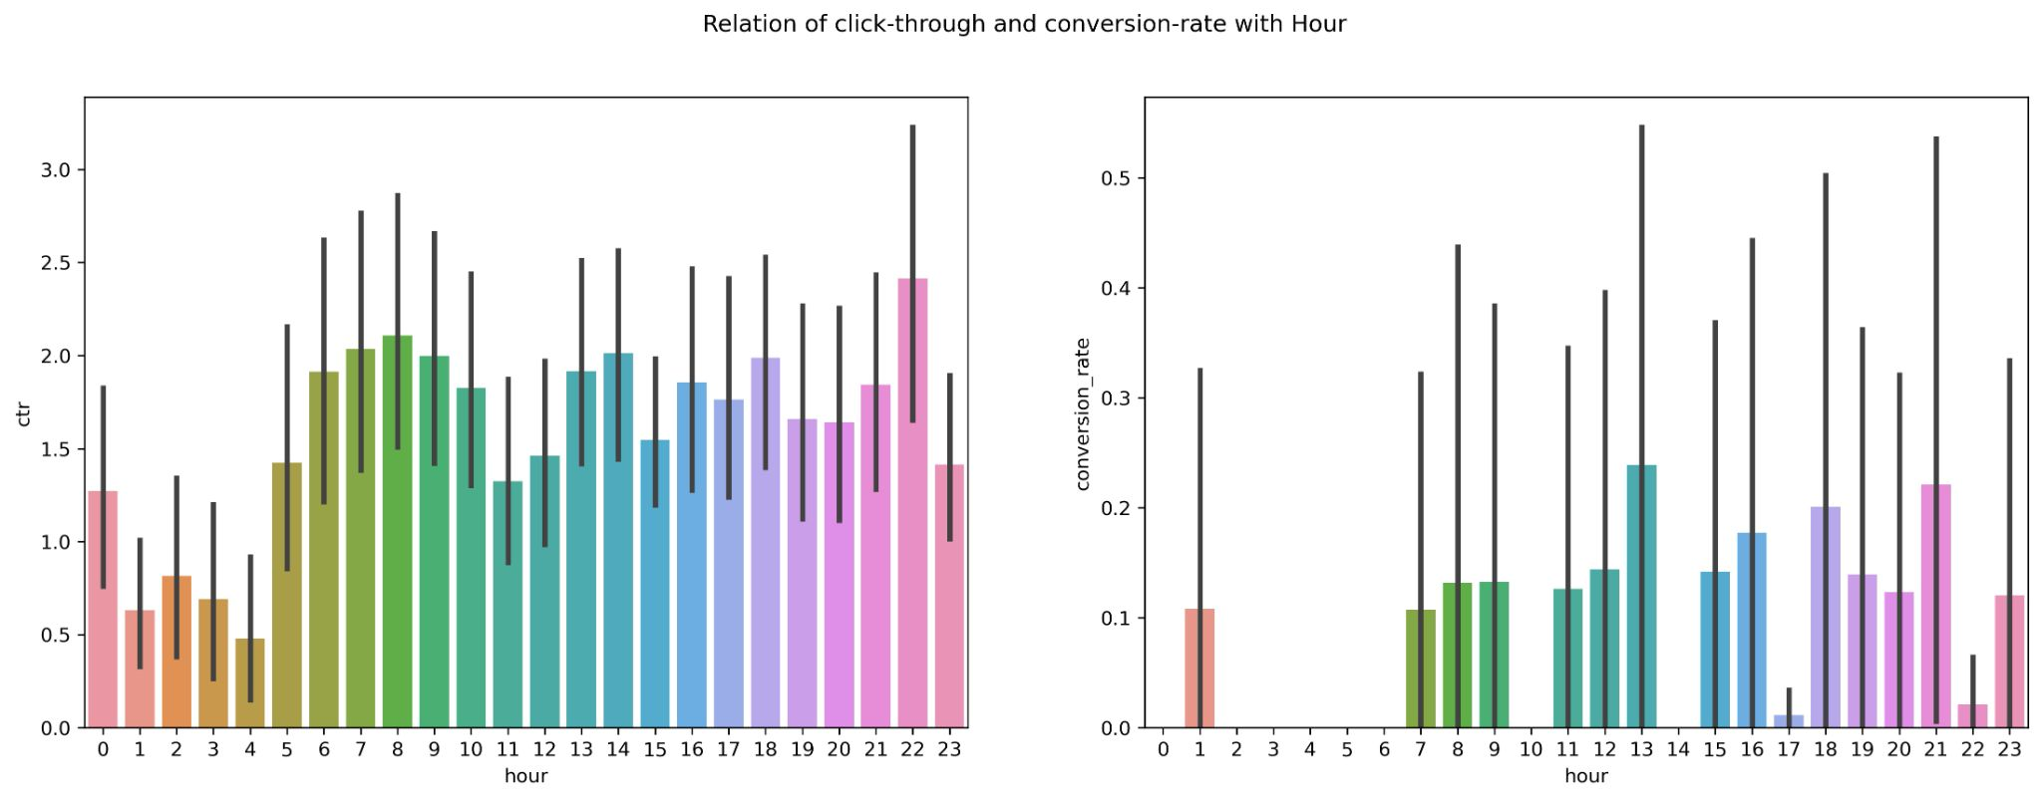
Data Processing: Explore Features
Hourly pattern spotted as conversion rate is high on hours 8, 13, 16, 22
Notes:
Check for patterns
Impact Of features
Correlation Matrix
Linearity Check

Slide 16
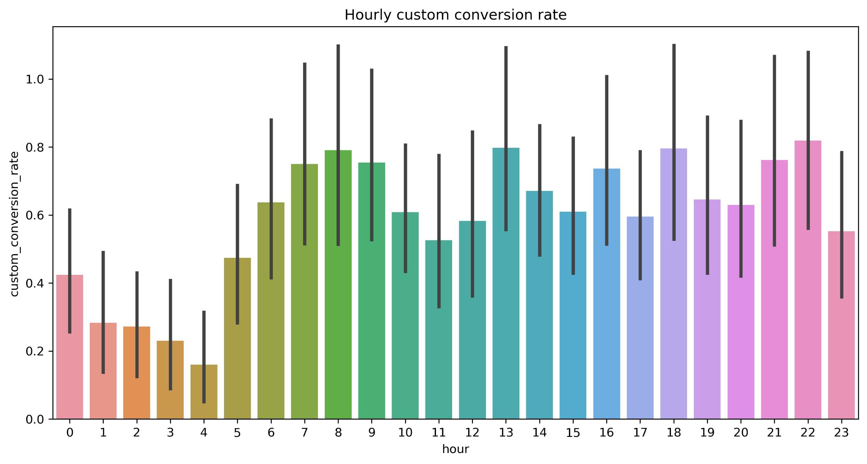
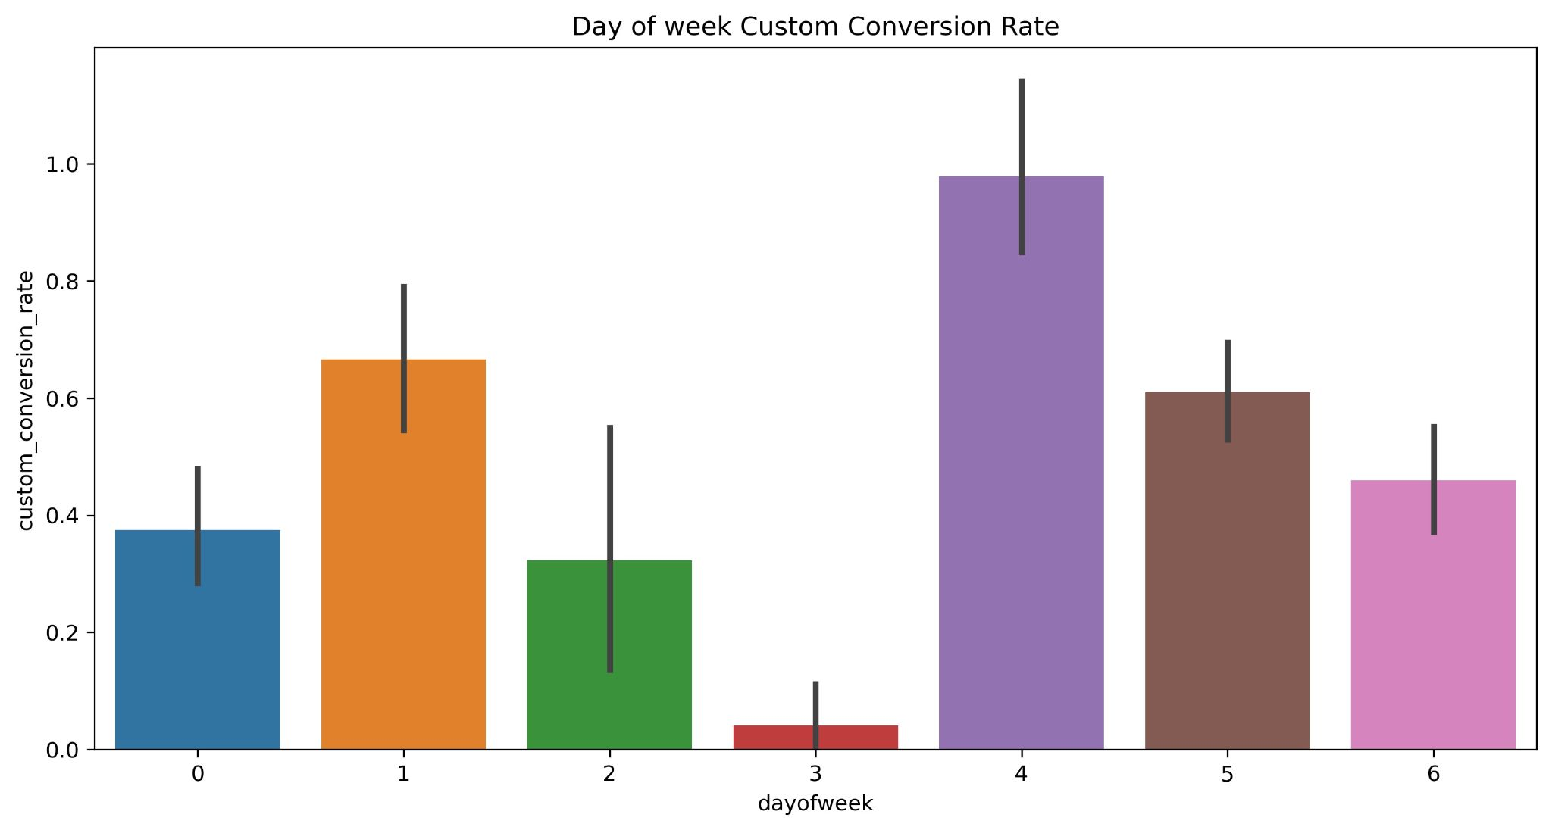
Data Processing: Explore Features-time
Hourly pattern spotted as conversion rate is high on hours 8, 13, 16, 22
Friday seems to be the most effective
Thursday is the least impactful one

Slide 17
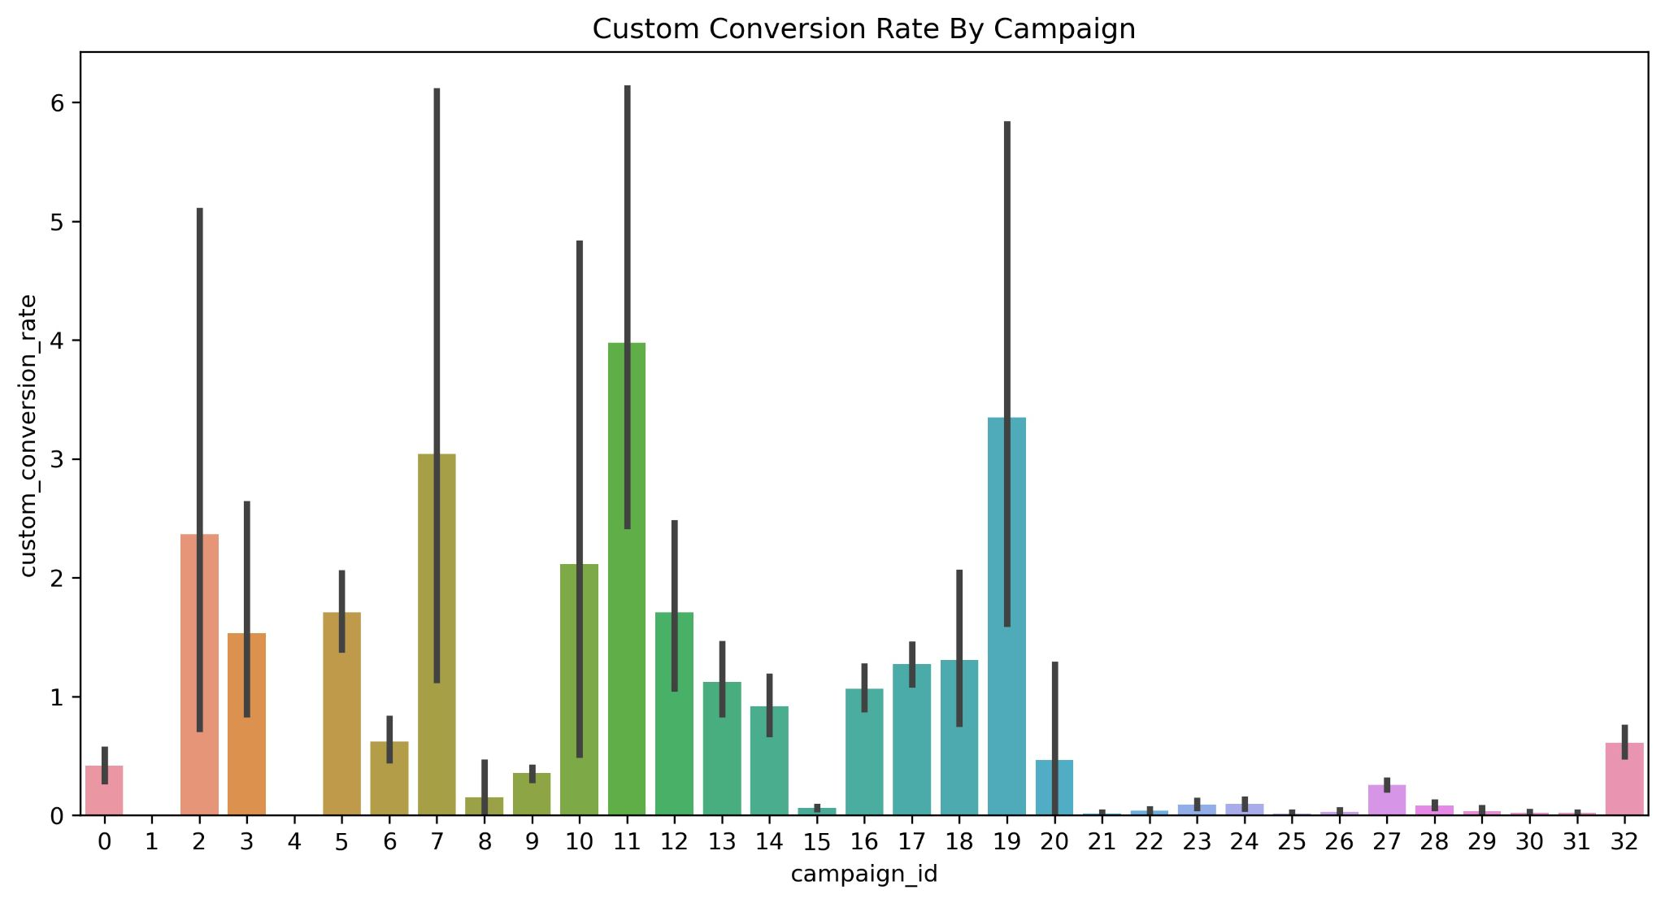
Data Processing: Explore Features-campaign
Certain campaigns has more impact on conversion
Notes:
Check for patterns
Impact Of features
Correlation Matrix
Linearity Check

Slide 18
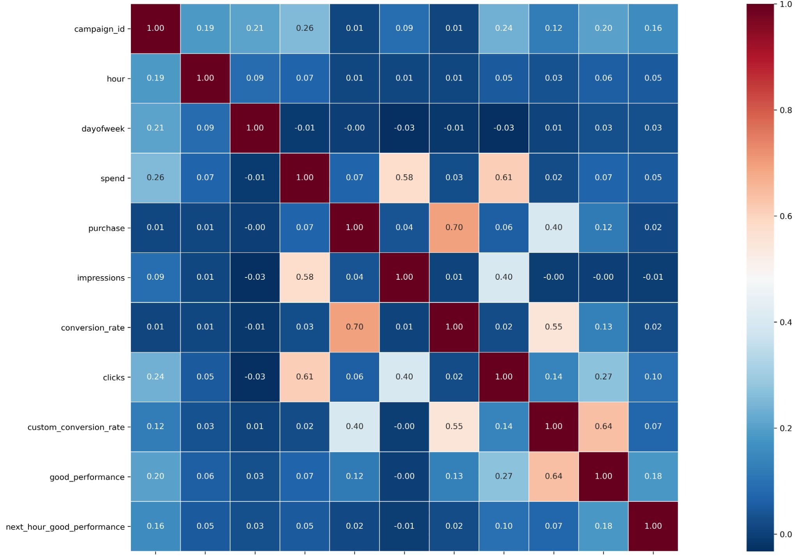
Data Processing: Selected Features
Excluded click through rate as it had high relationship with multiple features
Still, certain features has higher colinearity amongst themselves but acceptable
Notes:
Check for patterns
Impact Of features
Correlation Matrix
Linearity Check

Slide 19
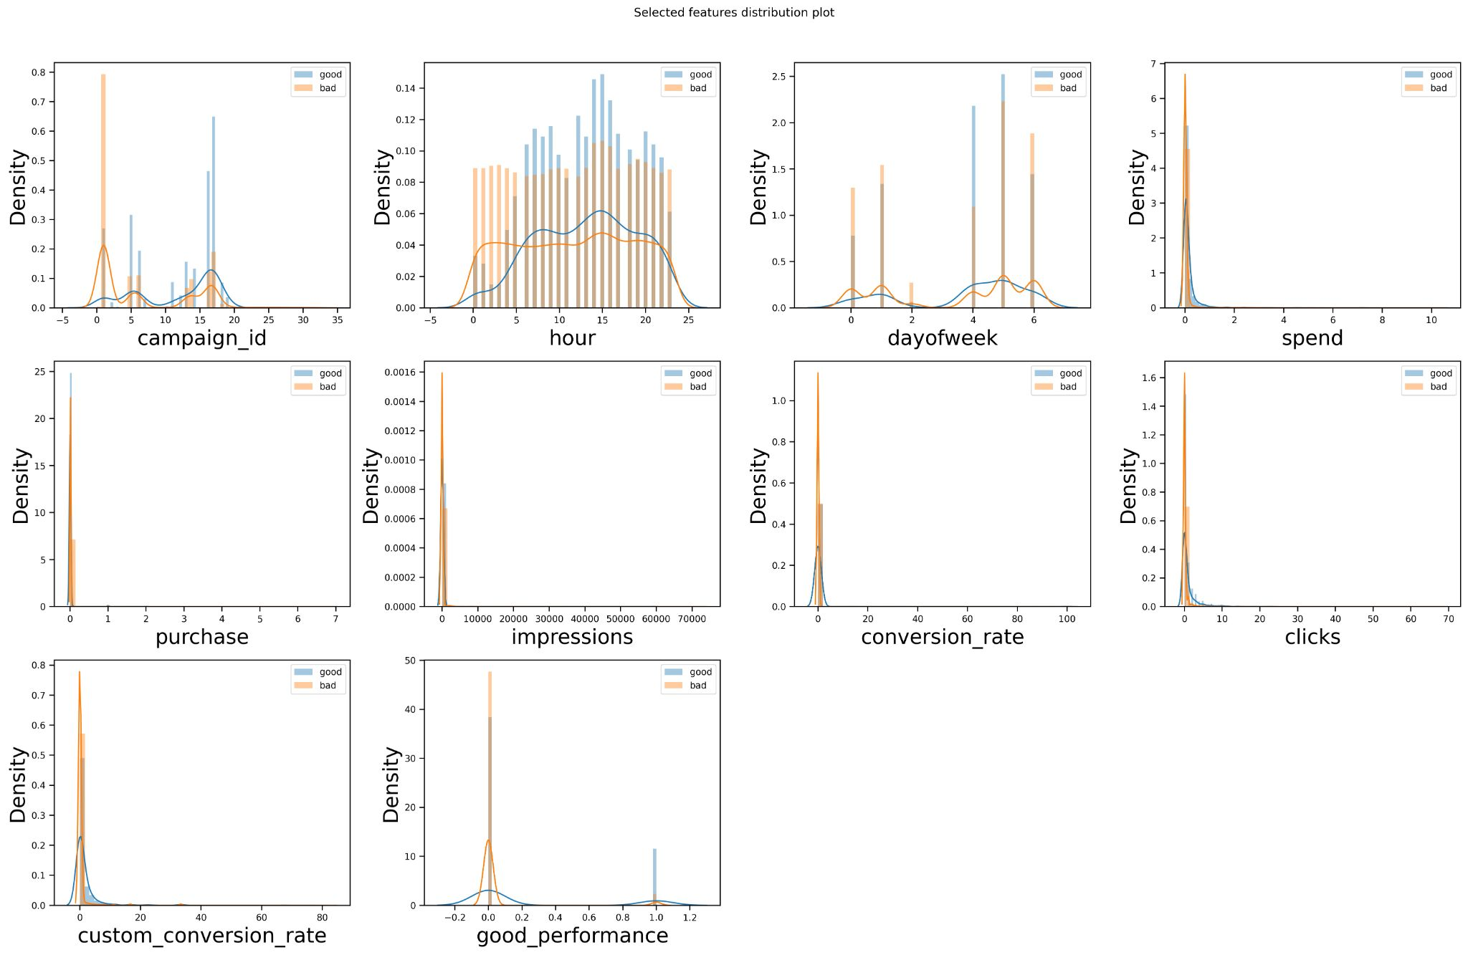
Data Processing: Feature Distribution with target
Both good and bad performed ads have acceptable distributions

Slide 20
Possible Baseline Models

Slide 21
Possible Baseline Models
Tree Based Models
Random Forest: uses fully grown decision trees using random subsets(i.e. bagging)
XGBoost: sequential trees and level wise tree growth
LightGBM: sequential trees and leaf wise tree growth
Ensemble of the above models
Notes:
Decision trees are better when data is highly skewed.
->Bagging decreases high variance to lower
->GBM are more sensitive to overfitting as they consists of training weak learners or shallow trees

Slide 22
Model Training

Slide 23
Model Training: Optimization Technique
Optimization algorithm
Bayesian optimization
Cross validation
3 fold Cross Validation
Common Optimization Parameters in all models
n_estimators, max_depth, class_weght
Notes:
Bayesian Optimization: a predictive model referred to as "surrogate" is used to model the search space and utilized to arrive at good parameter values combination asap

Slide 24
Model Training: Evaluation Metrics

Slide 25
Model Training: Evaluation Metrics
PR-AUC(0<->1)
Area under the curve on precision-recall curve

Slide 26
Model Training: Evaluation Metrics
PR-AUC(0<->1)
Area under the curve on precision-recall curve
F1 Score(0<->1)
Harmonic mean of precision and recall

Slide 27

Model Training: Evaluation Metrics
PR-AUC(0<->1)
Area under the curve on precision-recall curve
F1 Score(0<->1)
Harmonic mean of precision and recall
Matthews correlation coefficient (-1<->1)
1 means perfect prediction
0 implies random prediction

Slide 28
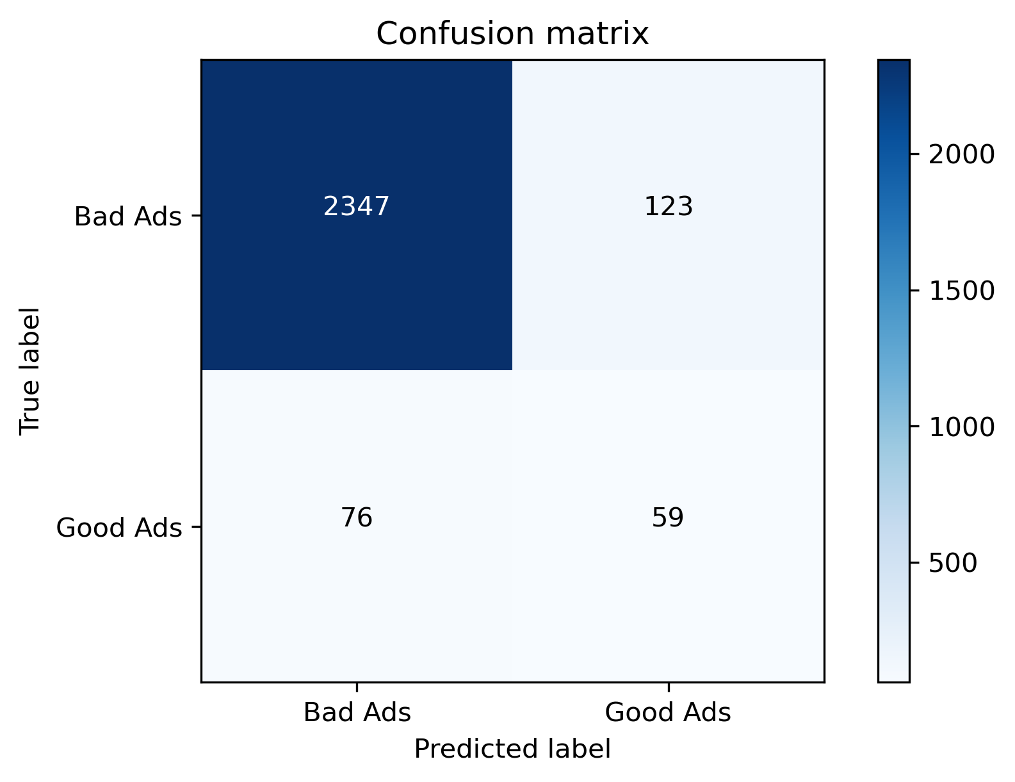
Model Training: Sample Quantitative Error Analysis
XGB Model

Slide 29
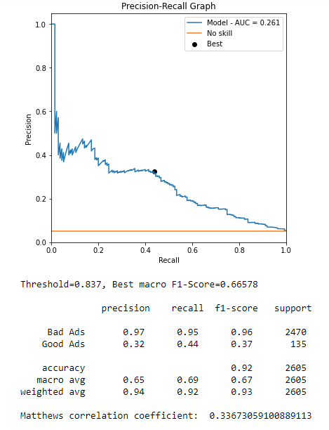
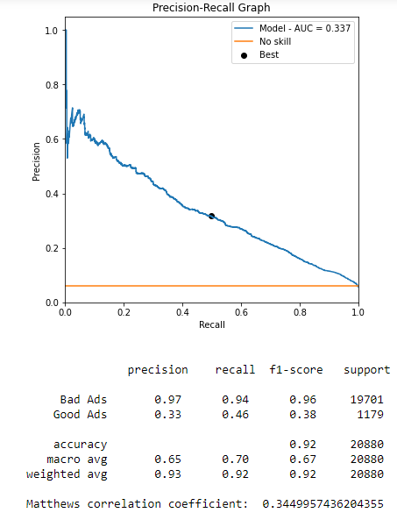
Model Training: Sample Quantitative Error Analysis
XGBoost: Test Set Performance
XGBoost: Training Set Performance

Slide 30
Result Comparison

Slide 31
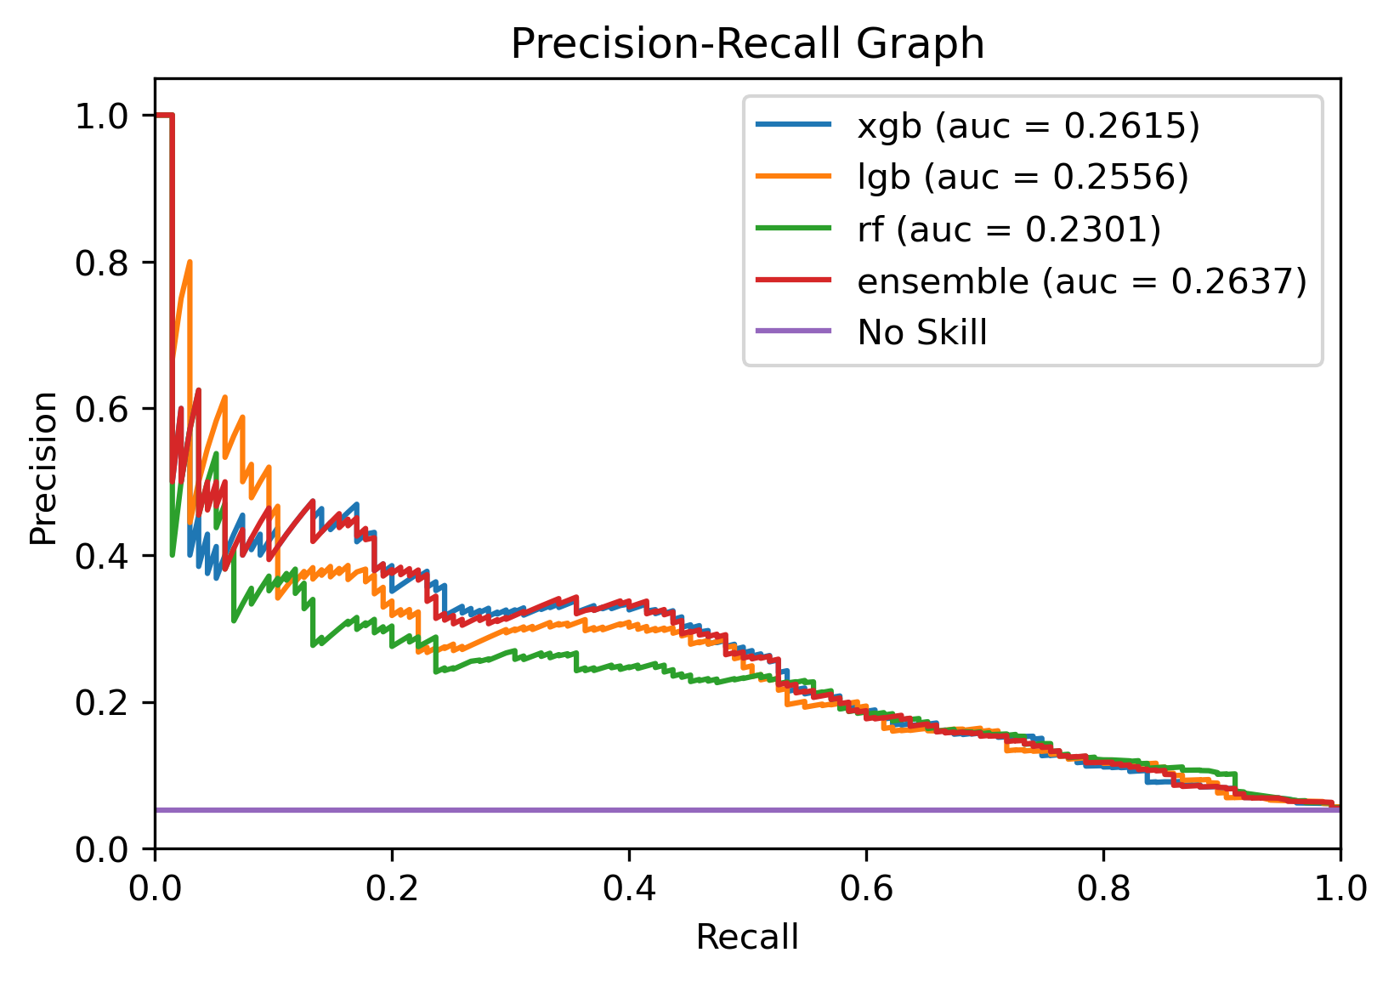
Result Comparison: Precision Recall Curve

Slide 32
Result Comparison
 |  | *Precision | *Recall | *F1 | PR-AUC | MCC
XGBoost |  | 0.646 | 0.693 | 0.665 | 0.261 | 0.336
LightGBM |  | 0.635 | 0.690 | 0.656 | 0.256 | 0.320
RF |  | 0.603 | 0.679 | 0.632 | 0.230 | 0.280
Ensemble Model |  | 0.652 | 0.685 | 0.667 | 0.264 | 0.336
* indicates macro averaged values

Slide 33
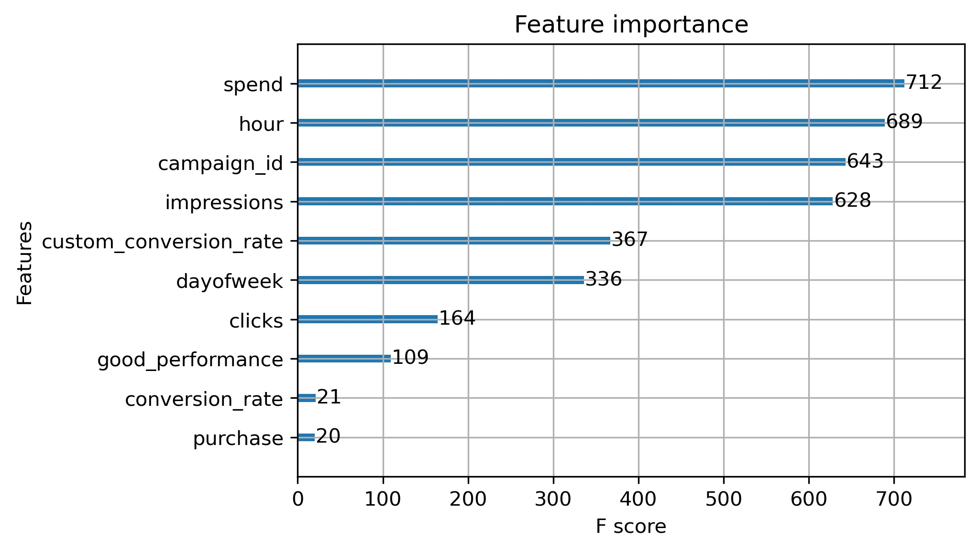
Result Comparison: Feature Importance by model

Slide 34
Further Improvements
Conduct error Analysis
Identify where and why baseline is failing to achieve desired outcome
Conduct ablation tests
Gather more features
ad banner info, website info
Explore different loss function i.e. focal loss, PR-AUC
Try Artificial neural network

Slide 35
Questions?
github-code-repo

